Slide 1
Maximizing Retail Sales Performance at Hybrid Stores
A Data-Driven Analysis of Sales, Cost, and Profit Trends

Slide 2
INTRODUCTION
Background
Hybrid Stores operates across 7 global regions and 20+ countries.
Over 8 years of successful operations with growing inventory.
Diverse product categories sold via multiple sales channels.
Management seeks to boost profitability through strategic insights.

Slide 3
OBJECTIVES
Identify high- and low-performing regions, products, and sales channels.
Analyse correlations between product type, sales volume, and profit.
Support executive decision-making with visual and quantitative evidence.
Improve inventory management and pricing strategies.
Analyse correlations between product type, sales volume, and profit.
Support executive decision-making with visual and quantitative evidence.
Improve inventory management and pricing strategies.

Slide 4
KPIs
Metric Purpose
Total Revenue (TR) Understand top-line income from sales
Total Cost (TC) Track business spending on products
Gross Profit (GP) Reveal profitability before tax
Net Profit (NP) Measure actual profit after tax (5%)
Avg. Net Profit (ANP) Assess overall profitability per transaction

Slide 5
KPIs CONT.
Units Sold (US) Track sales volume per item/region
Order Priority Impact Measure urgency-driven demand
Year-over-Year Profit Identify growth or decline over 8 years
Units Sold (US) Track sales volume per item/region

Slide 6
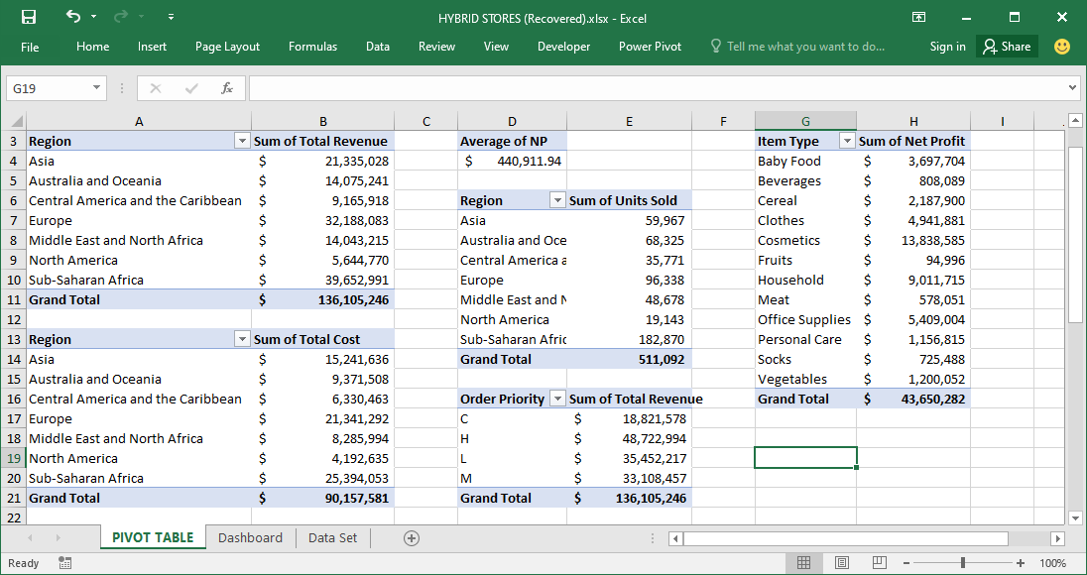

Slide 7
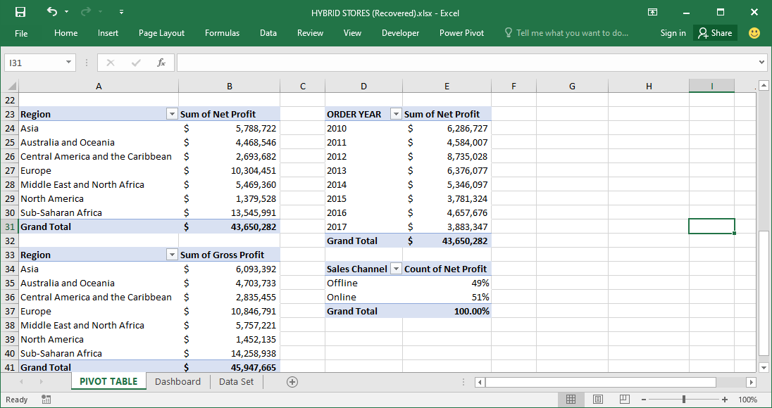

Slide 8
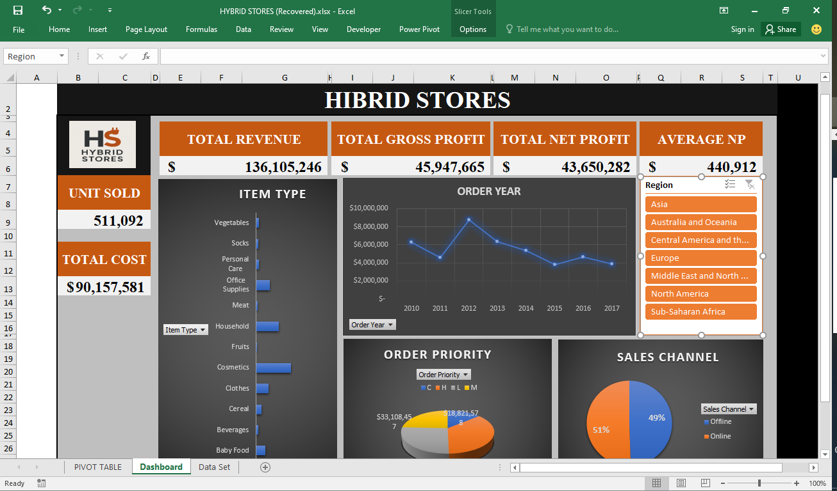

Slide 9
KEY FINDINGS
Item Type & Product Insights
High-revenue items include Household, CosmeticsBaby Food, Office Supplies, Cereal. Some items have high sales but low net profit — e.g., Fruits.
Regional Trends
Sub-Saharan Africa and Asia regions drive the highest volume.
Europe showed consistent but moderate returns.
Sales Channel Contribution
Offline channel leads in volume; Online shows higher margins.
Fruits underperforms in both sales and profit.

Slide 10
KEY FINDINGS CONT.
Order Priority Impact
High and Medium-priority orders generated the highest revenue.
Low-priority orders associated with lower sales and longer delays.
Yearly Trends
Net Profit grew steadily in Years 4–6, declined slightly in Year 7.
Cost growth outpaces revenue in some regions, requiring review

Slide 11
RECOMMENDATIONS
Short-Term (0–6 months)
Re-price low-margin items like Fruits to increase profit margin.
Invest in best-selling categories like Household, Baby Food, and Office Supplies.
Streamline logistics for high-priority orders to reduce delivery time.
Mid-Term (6–12 months)
4. Optimize regional operations by expanding in top-performing countries.
5. Review sales channel investments — boost Online for higher margins.
6. Automate KPI tracking dashboards using Excel Pivot + Power BI/Tableu

Slide 12
RECOMMENDATIONS CONT.
Long-Term (>1 year)
7. Introduce customer behaviour analysis using purchase history.
8. Train regional managers on using data for strategic decision-making.
9. Implement smart inventory tools to reduce dead stock.
10. Expand into underperforming but promising markets cautiously

Slide 13
THANK YOU
Looking forward to your feedback and questions.

